Slide 1

Oriental Institute of Science and Technology, Bhopal
Gesture Based Paint Application
Guide :
Prof. Bhavana Choubey
(Department of Computer Science & Engineering)
Group Members :
Faiza Khan 0105CS181039
Ashi Yadav 0105CS181027
Palak Bhargava 0105CS181032

Slide 2

Table of Content
1. Introductory Information
2. Aim Of the Project
3. Scope
4. How It Works ?
5. Software/Hardware requirements
6. Salient Features
7. Why We Need This Project?
8. How it Reduced cost?
9. Motivation for this Project?
10. Features Of Real Time Gesture
Based Paint Application
11. ER diagram
12. Flow Chart Diagram
13. Activity time chart
14. Keyboard controls
15. Code Explanation
16. General view of painting
tool
17. Future Enhancements and Limitation
18. Conclusion
19. Bibliography

Slide 3
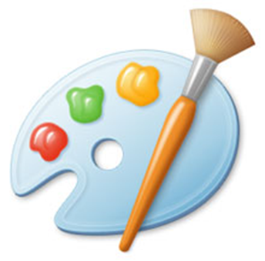

Introductory Information
A paint program is a software graphics program that allows the user to draw or paint bitmapped images on a computer.
This project allows user to draw on screen with full ease using real time hand gestures. The application also allows user to switch between brush size and paint colours..

Slide 4

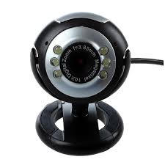
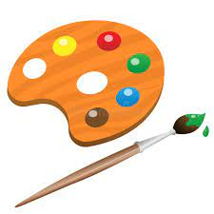
Aim Of the Project
The Aim of this project is to make the process of painting more user friendly by using webcam of computer to track the motion of an object and use it as paint brush.

Slide 5

Scope
The proposed system helps the user to perform hand gesturing in an efficient and cost effective manner.
Using Machine learning, we can eliminate cost factor as well as noise or any type of barrier easily.
With small modification to the proposed system it can be used in many other fields.

Slide 6
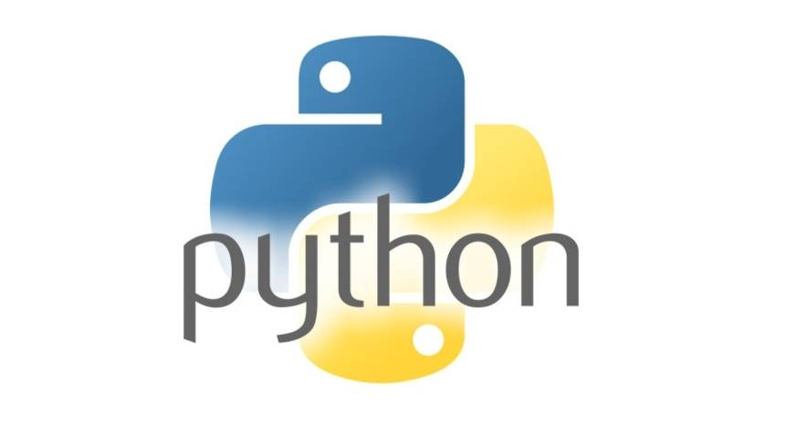

How It Works ?
Given the real time webcam data, this paint-like python application uses OpenCV library to track an object of interest and allows the user to draw by moving the object, which makes it both awesome and challenging to draw simple things.
+

Slide 7
Software Requirement Specification
Python
Open CV library
Numpy library
Hardware Requirement Specification
Computer
Camera

Slide 8

Salient Features
This project allows user to draw on screen with full ease using real time hand gestures. The application also allows user to switch between brush size and paint colours. It also contains many other features.

Slide 9
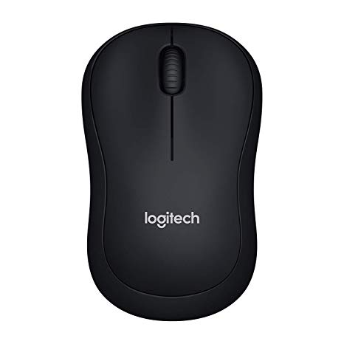
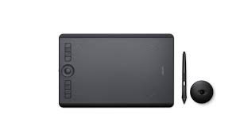
Why We Need This Project ?
In current scenario MS Paint or different paint software’s are used for editing or drawing images on screen with traditional pointing devices. For editing image or drawing shape user do not have any other option except keyboard mouse to use paint software.

Slide 10
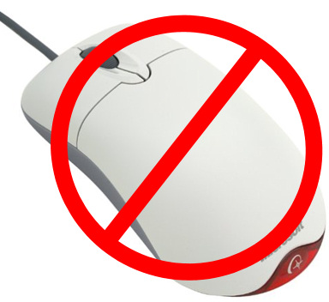
How It Reduces Cost ?
As device or hardware interface is required to use software which impacts on cost of the project or system. So to avoid this we are proposing a Smart paint software which can be used without any hardware interface.

Slide 11

Motivation For The Project
Hand gestures are best way to communicate with computer system. Almost all paint programs are more or less similar on the basis of their functionality and the way user gives input. This gives EDGE to our project.

Slide 12
Features Of Real Time Gesture Based Paint Application

Slide 13
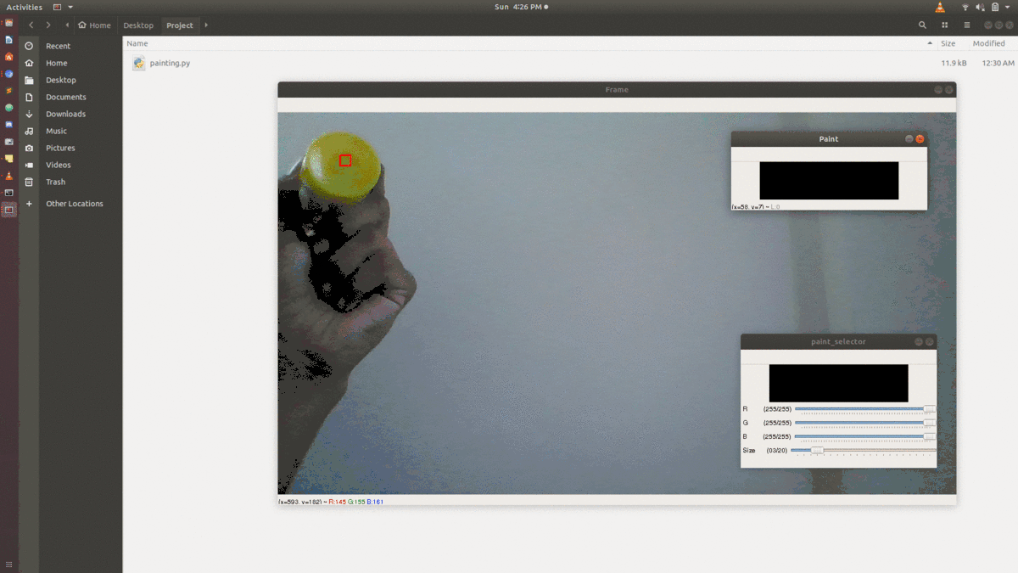
Freedom To Choose Any Object For Drawing

Slide 14
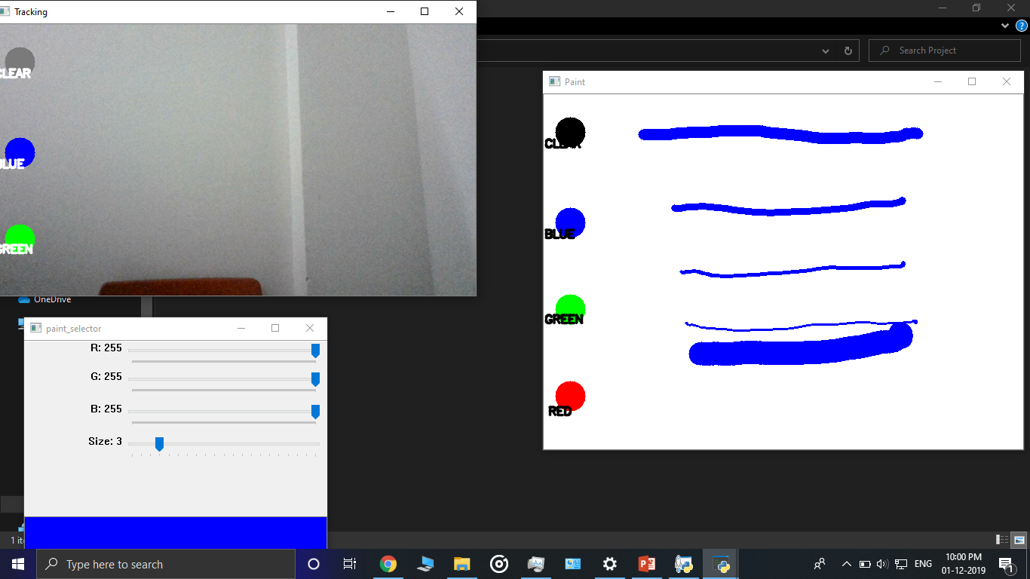
Choose From Different Brush Sizes

Slide 15
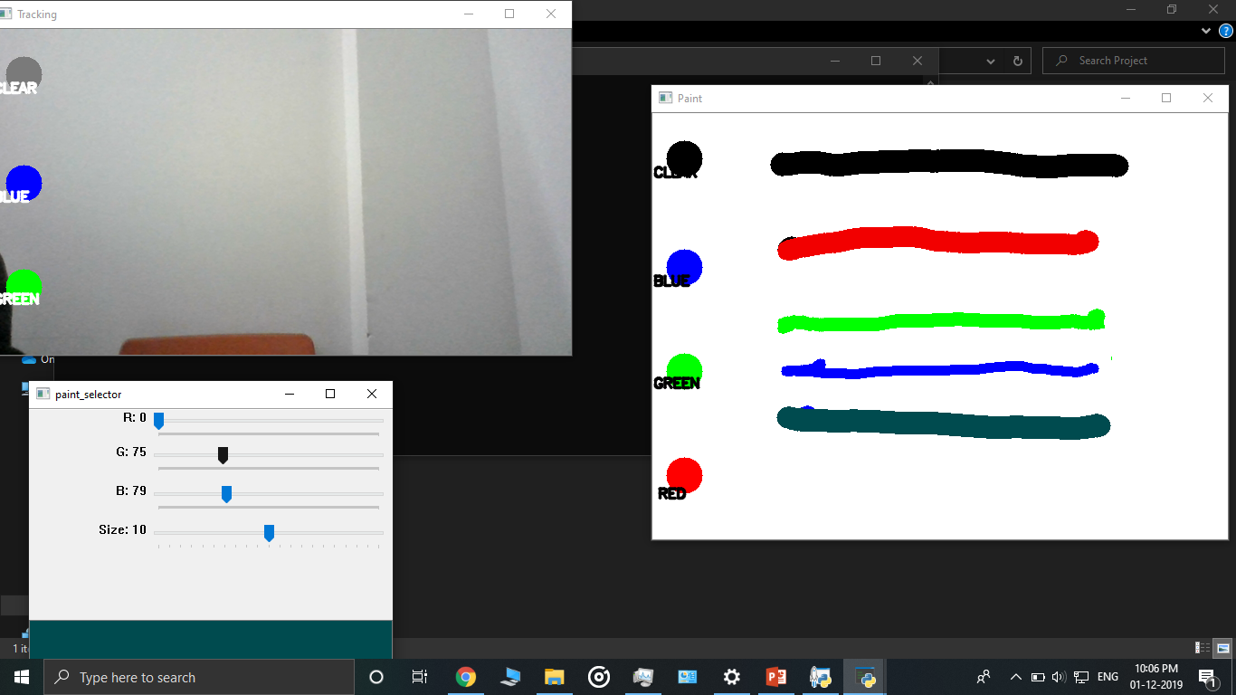
Large Variety Of Color Range

Slide 16
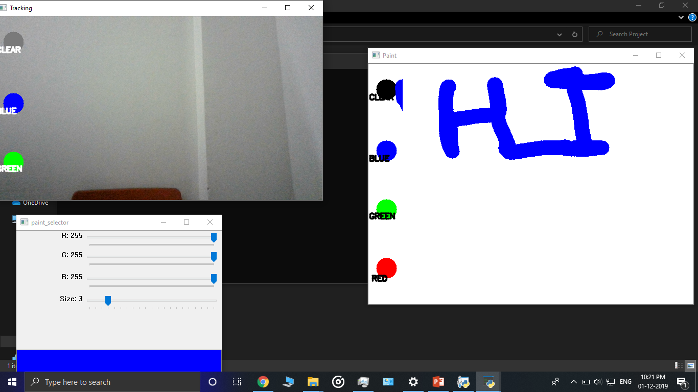
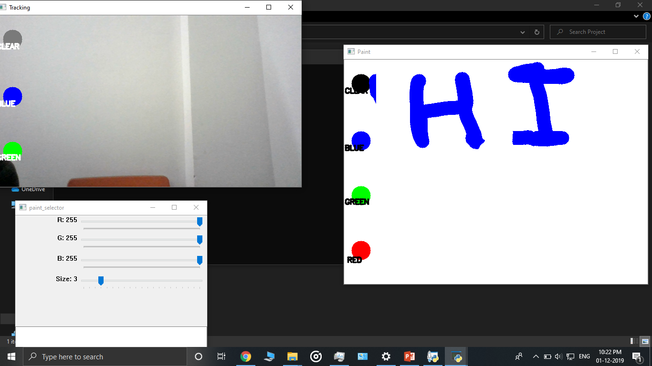
On Demand Eraser Tool
>
BEFORE
AFTER

Slide 17
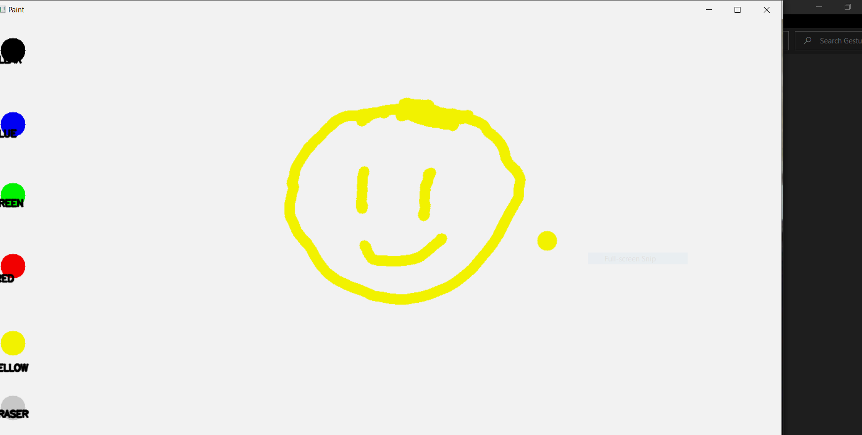
Brush Pointer

Slide 18
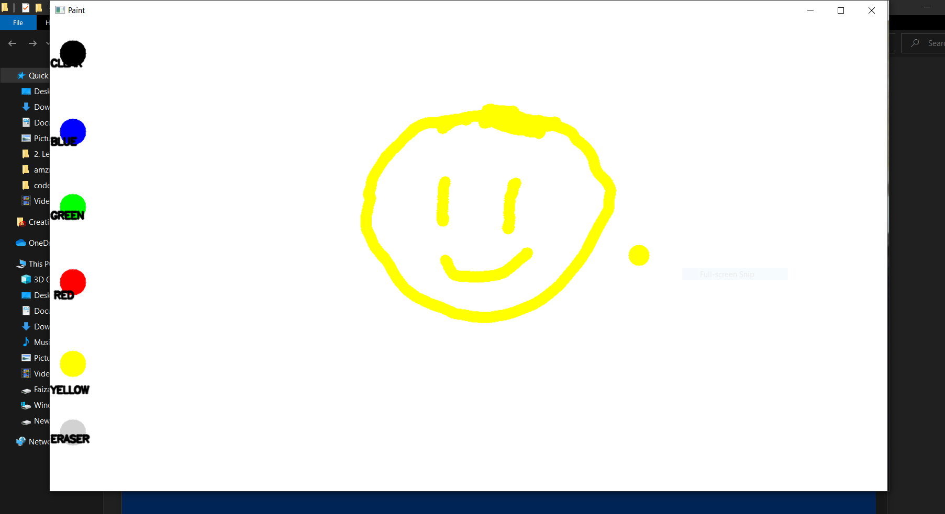
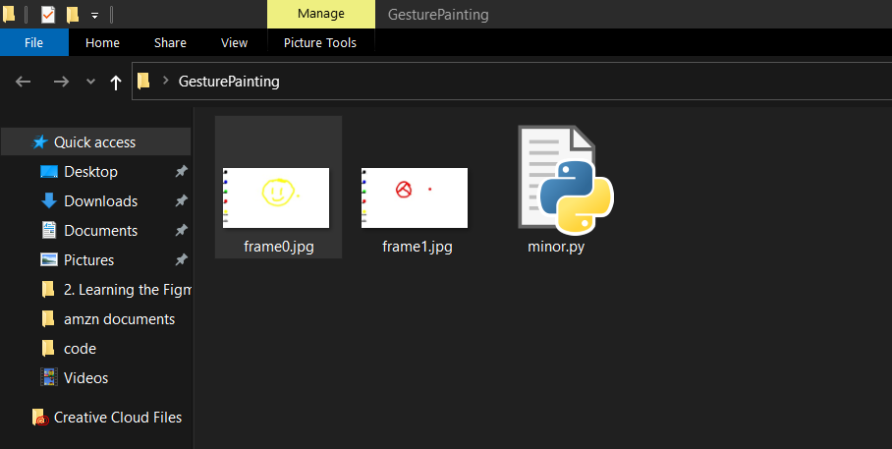
Save Painting

Slide 19
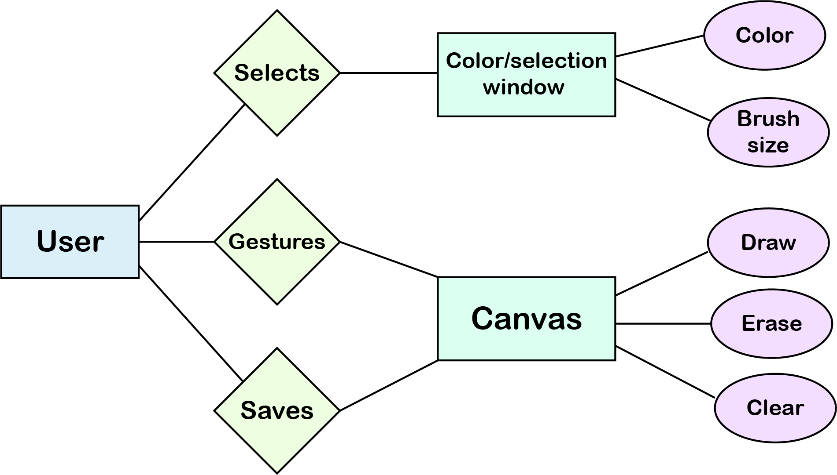
E-R diagram

Slide 20
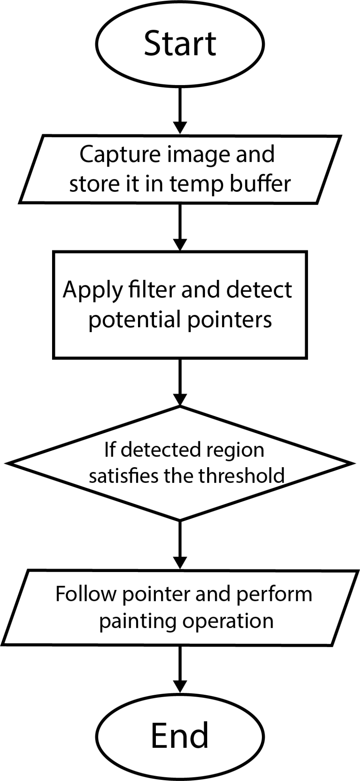
FLOW CHART DIAGRAM

Slide 21
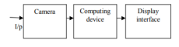
GENERAL VIEW OF PAINTING TOOL

Slide 22
Activity Time Chart
Week 1-2
Week 3
Week 4
Week 5
Week 6
Week 7
Learn Python and its libraries such as numpy, collections, etc.
Analyzing requirements and setting up the environment.
Learning and testing some basic programs in OpenCV.
Implementing the paint application windows and object detection.
Adding basic features to the project , eg: switching between colors, changing brush size, etc.
Adding advanced features and testing the project in different environments.

Slide 23
KeyBoard Controls
S - Enable/Disable Brush
M – Increase Brush Size
N – Decrease Brush Size
P – Save The Drawing
Q – Quit The Application
L – Choose Color From Color Slider

Slide 24
{ CODE }
EXPLANATION

Slide 25
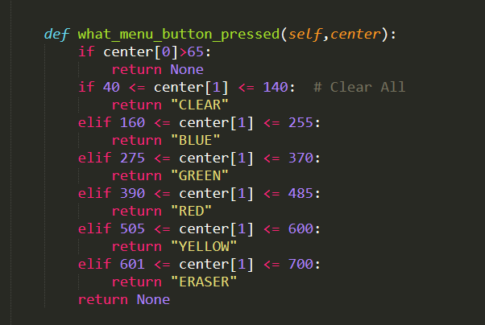
1. SELECTION OF COLORS/CLEAR BUTTON/ERASER

Slide 26
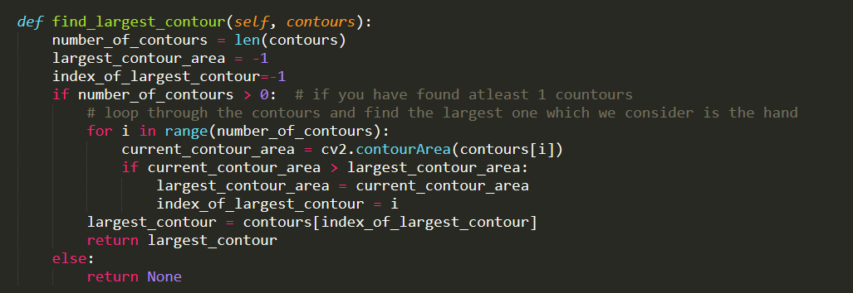
2. FINDING LARGEST CONTOUR OF ALL CONTOURS

Slide 27
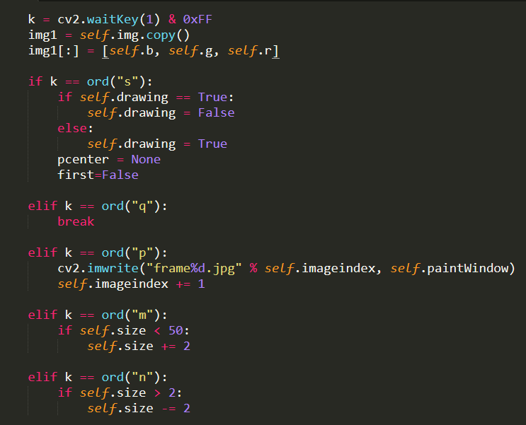
3. KEY MAPPINGS FOR VARIOUS FUNCTIONS

Slide 28
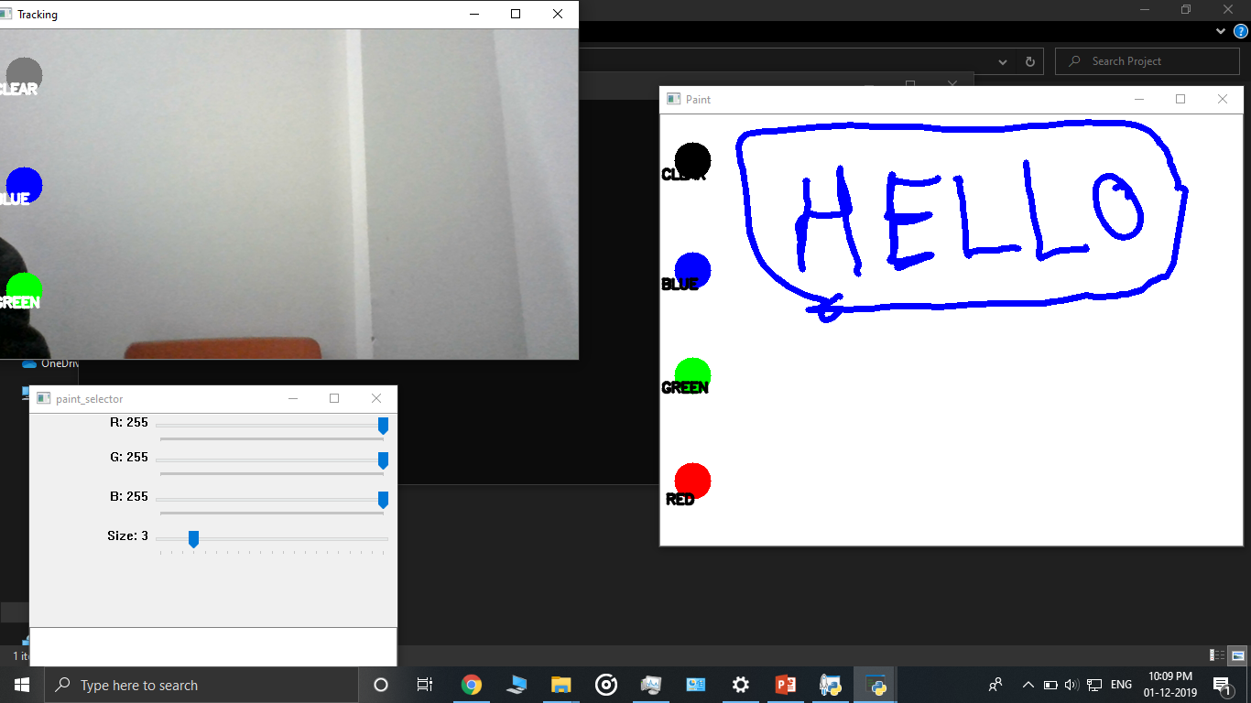
Demo Illustration Of Project

Slide 29
Future Enhancements
Working on User Interface and User Experience.
Increasing accuracy in detecting contours.
Fill color function.
Limitations
In case of more than one contour, the application chooses the largest one.

Slide 30
Conclusion
In the modern digital age of social media where the photos and images have much importance, there is a need for user friendly painting tool. The intention of this painting tool is to provide accurate and convenient pointing device. This project aims to bridge the gap between machines and humans. Controlling the computer system using movements detected in camera is more user friendly than traditional methods. OpenCV library has been preferred for this method.

Slide 31
Bibliography
https://docs.opencv.org/master/d6/d00/tutorial_py_root.html
https://en.wikipedia.org/wiki/OpenCV
https://www.researchgate.net
https://www.pyimagesearch.com/2018/07/19/opencv-tutorial-a-guide-to-learn-opencv/

Slide 32
THANK YOU ...!

